Slide 1
PyFock
Figures

Slide 2
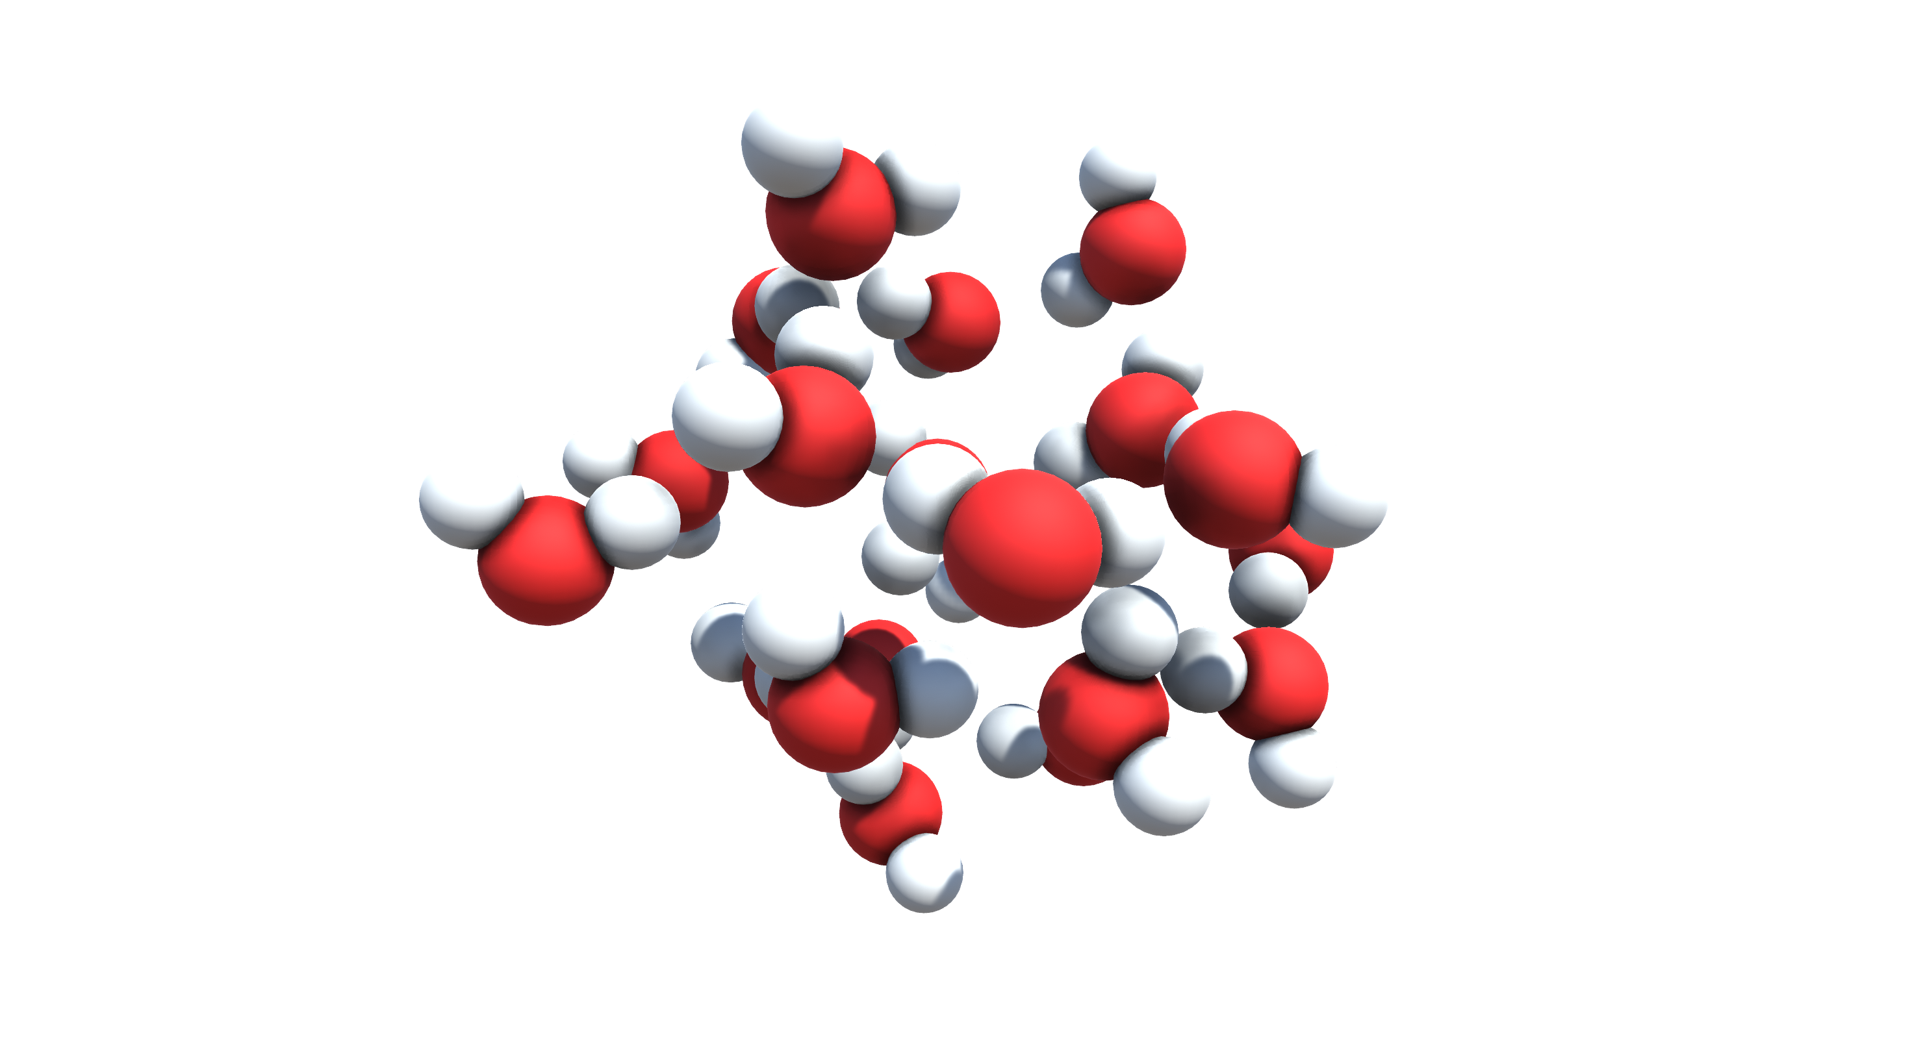
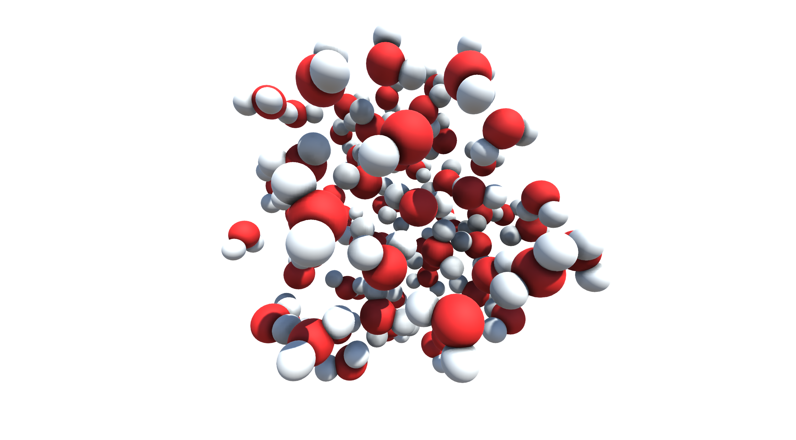
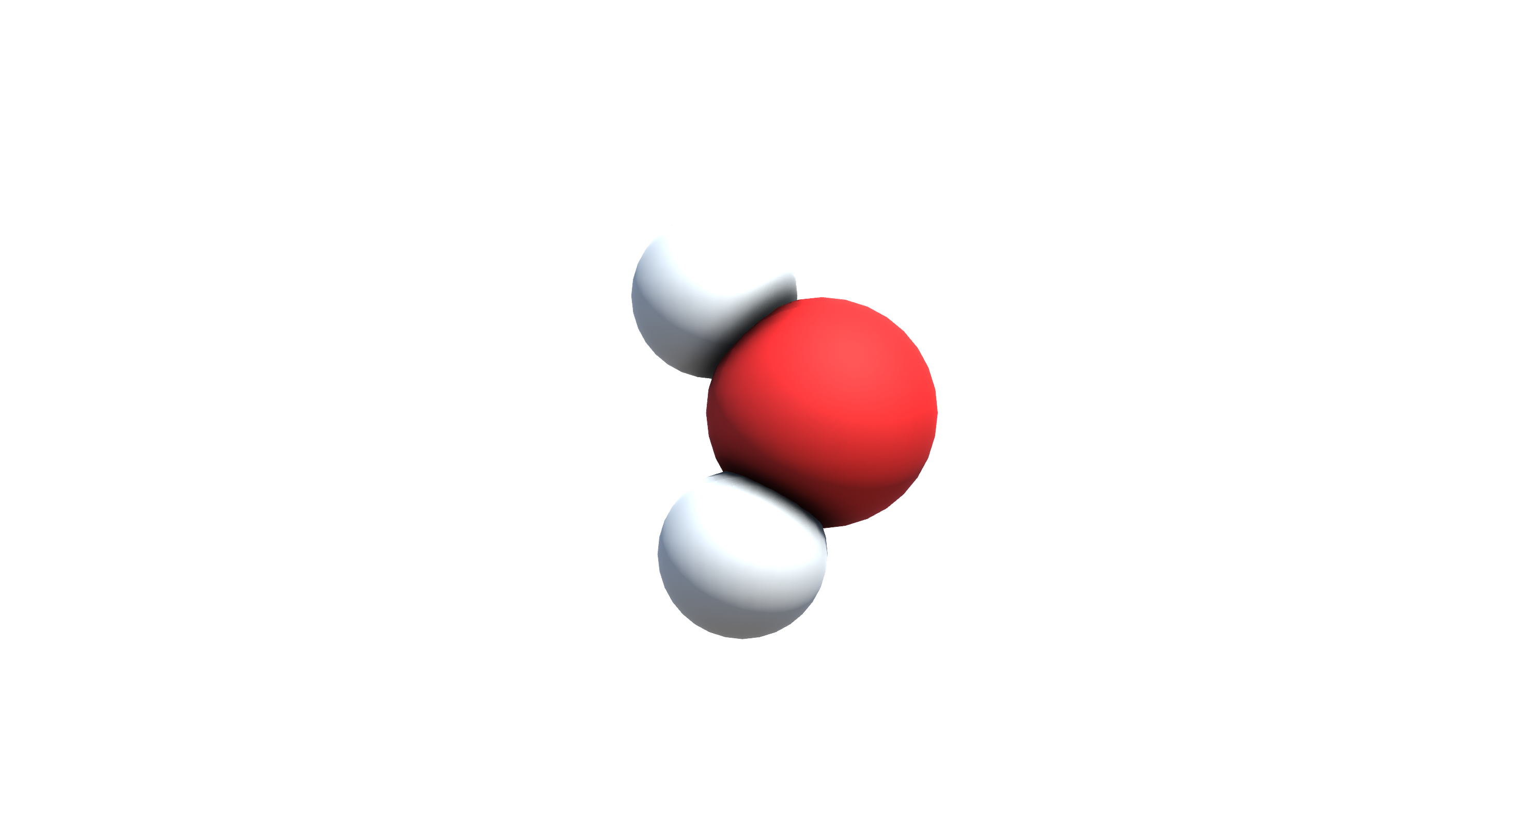
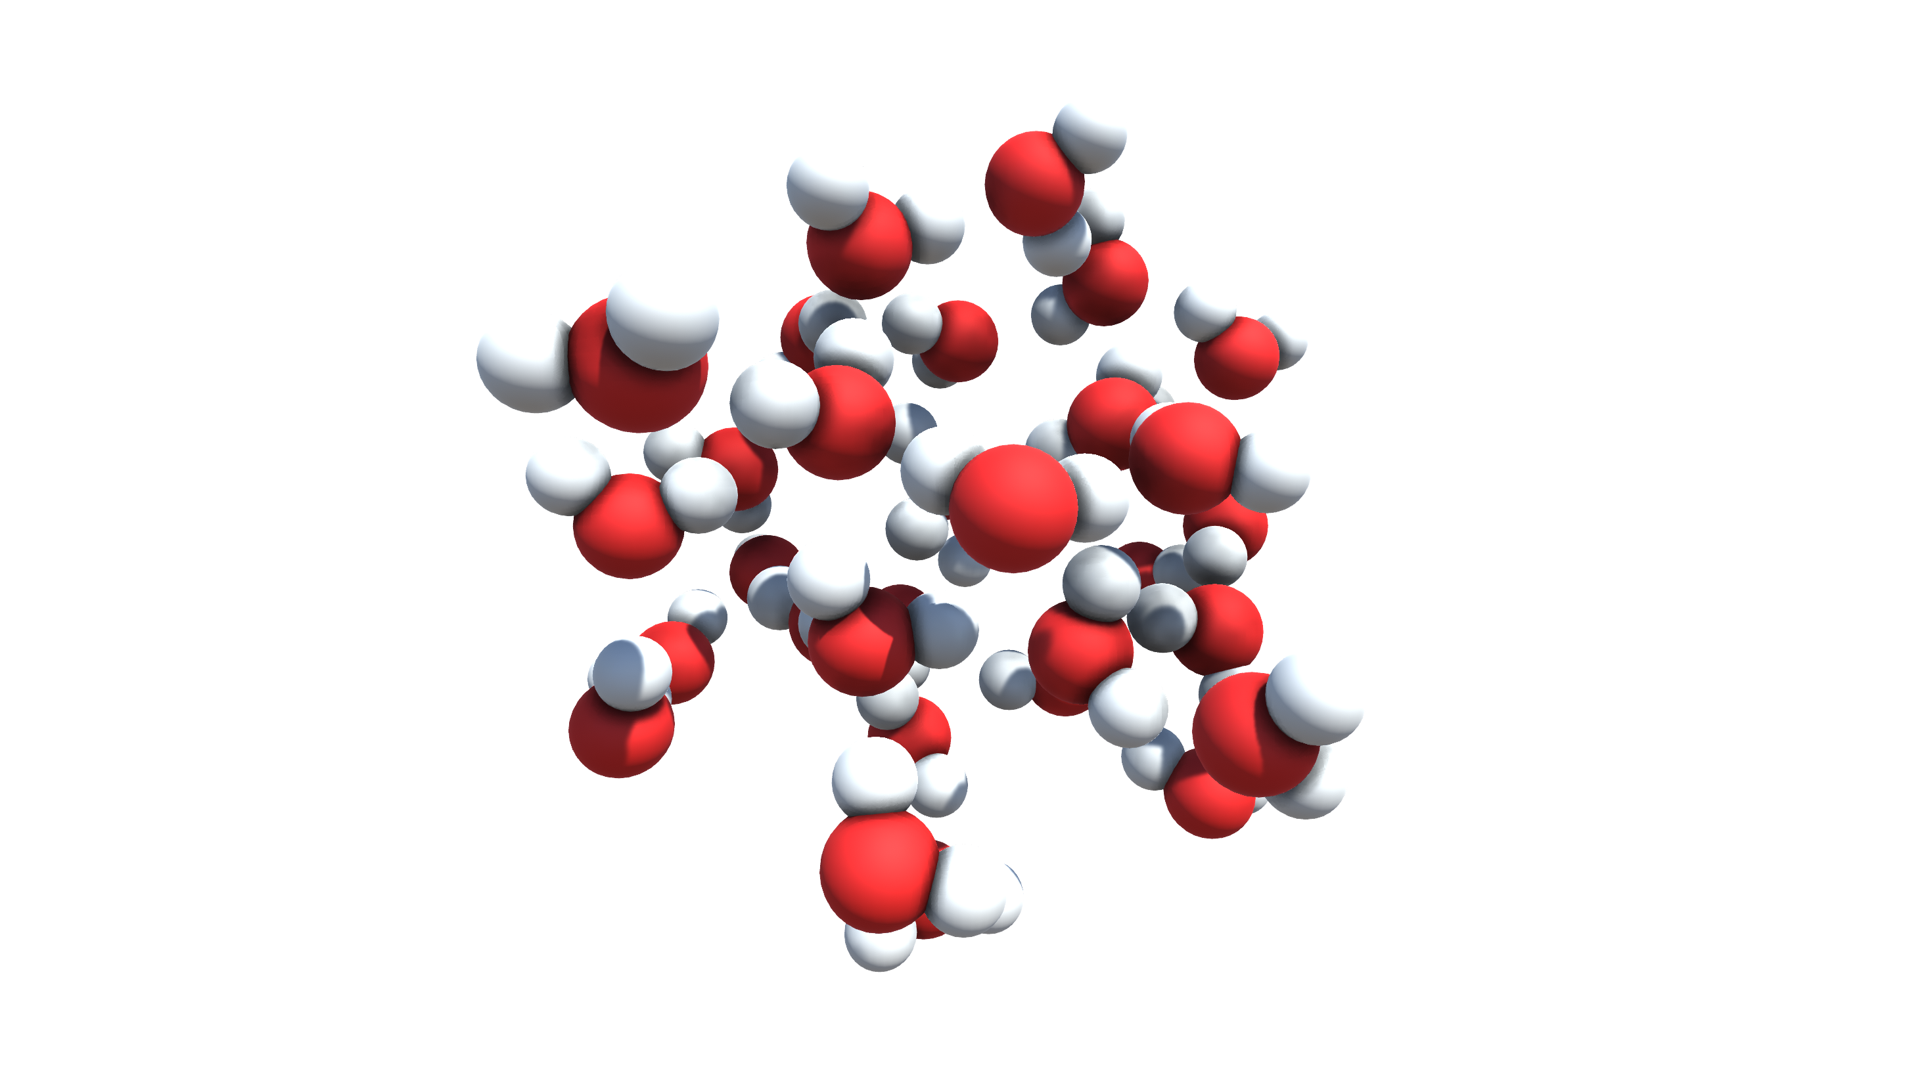
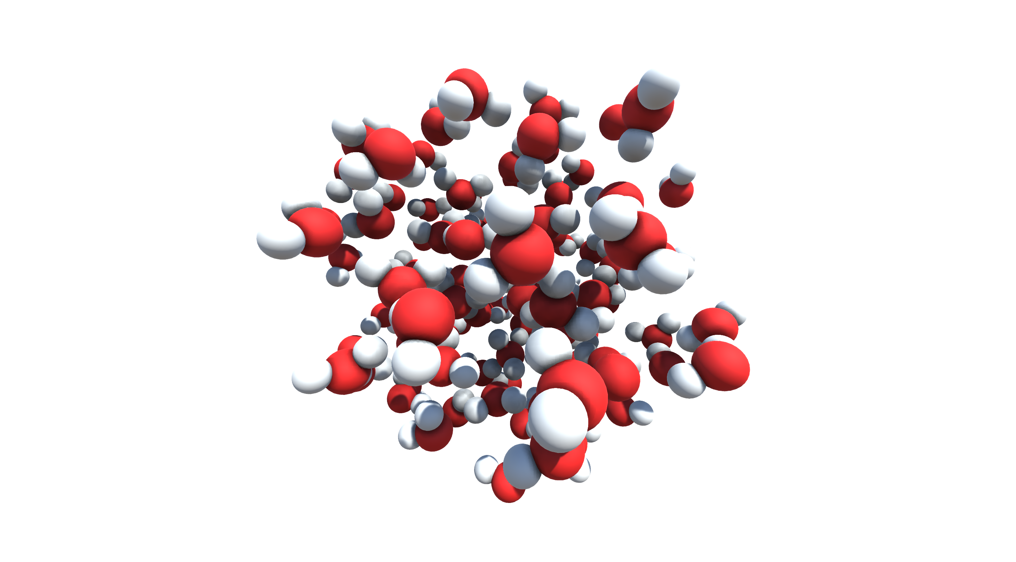
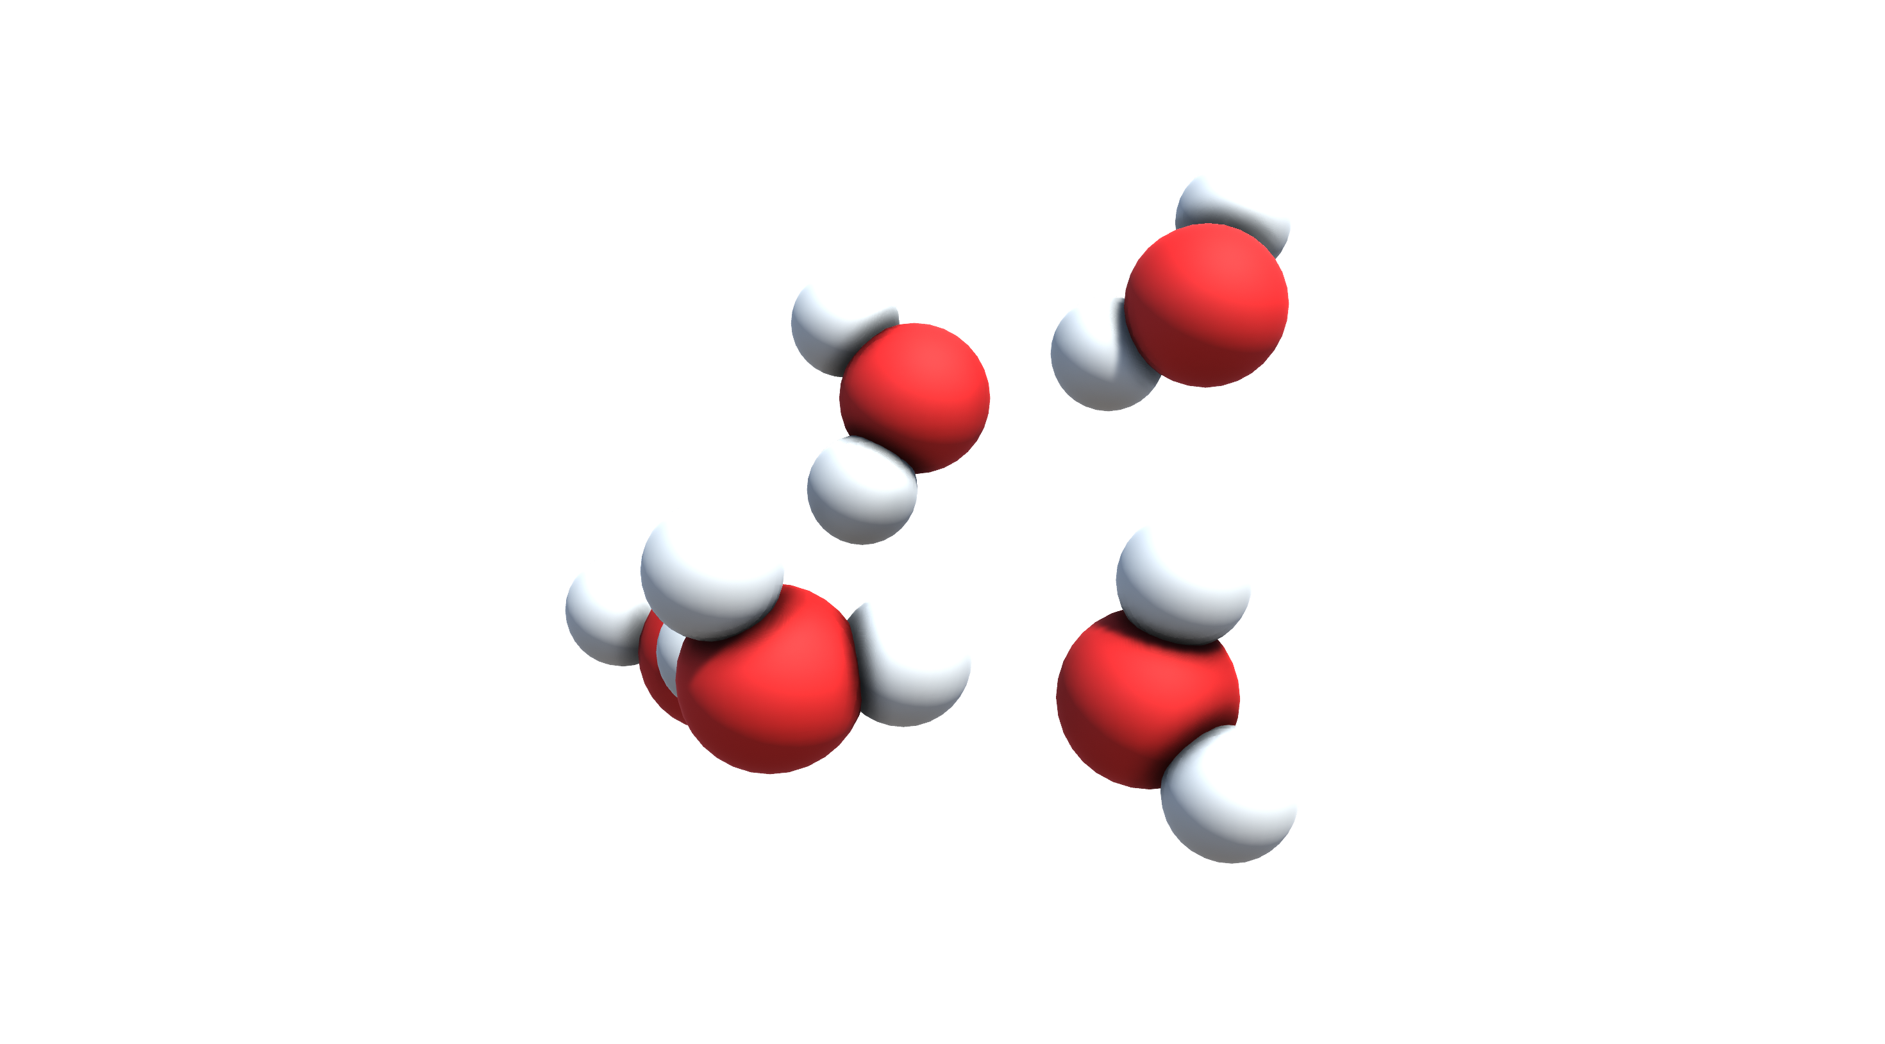
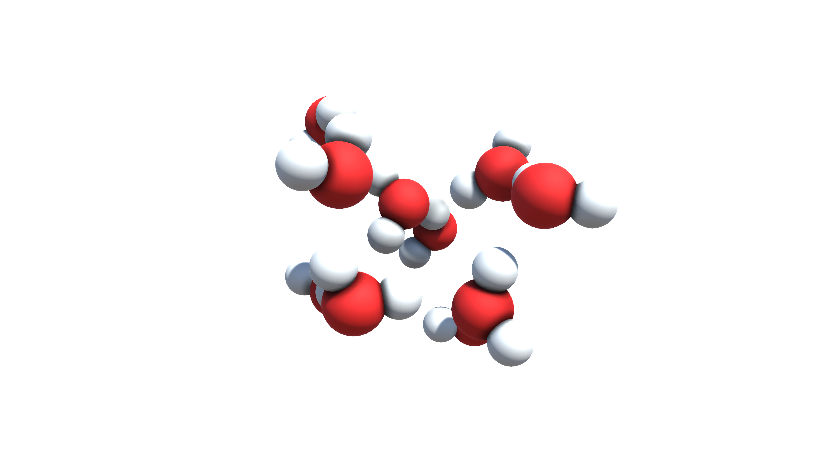
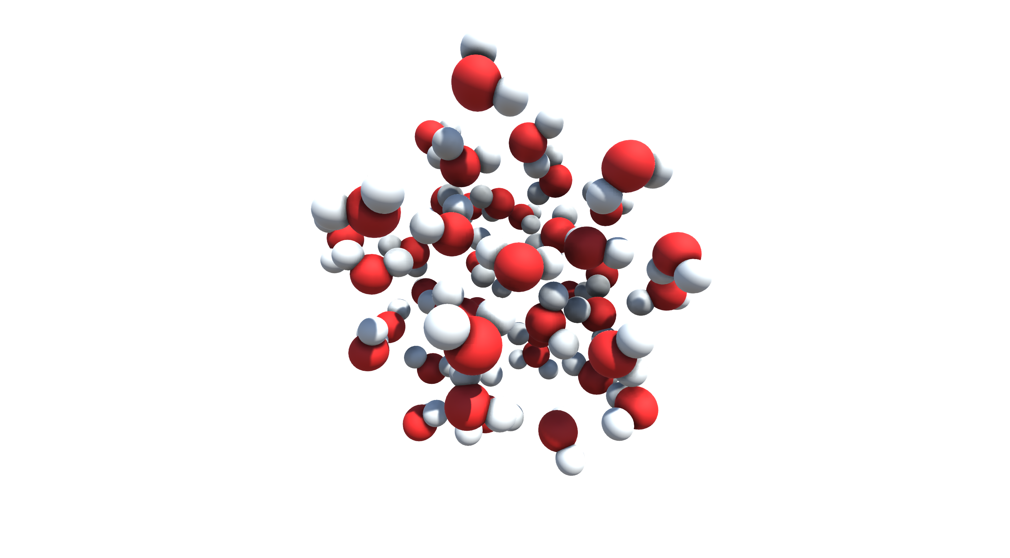
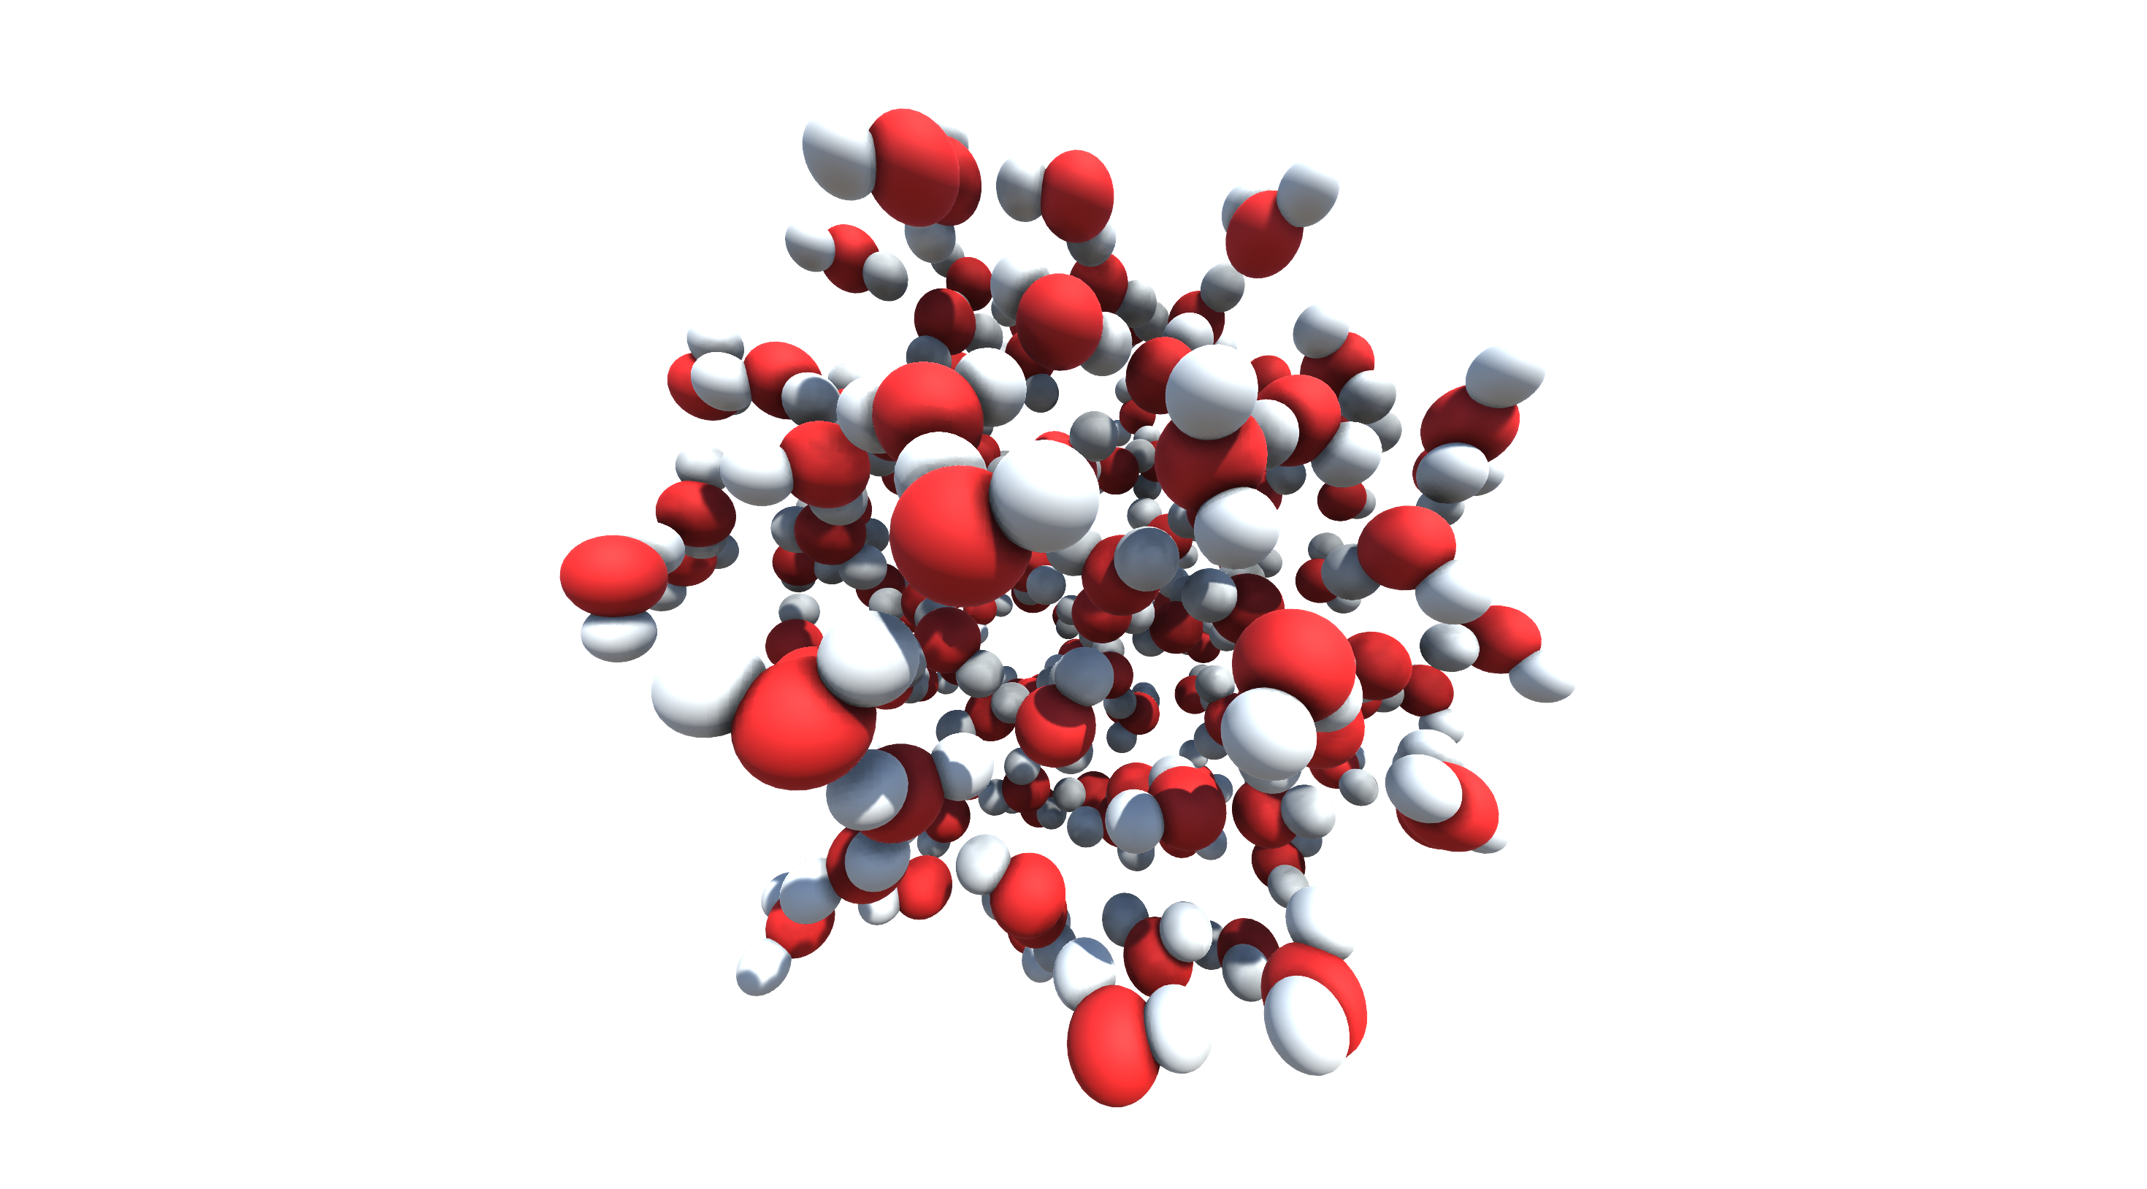
(a)
(d)
(g)
(H₂O)₁
(H₂O)₂₀
(H₂O)₇₆
(b)
(e)
(h)
(H₂O)₅
(H₂O)₃₂
(H₂O)₁₀₀
(c)
(f)
(i)
(H₂O)₁₀
(H₂O)₄₇
(H₂O)₁₃₉

Slide 3
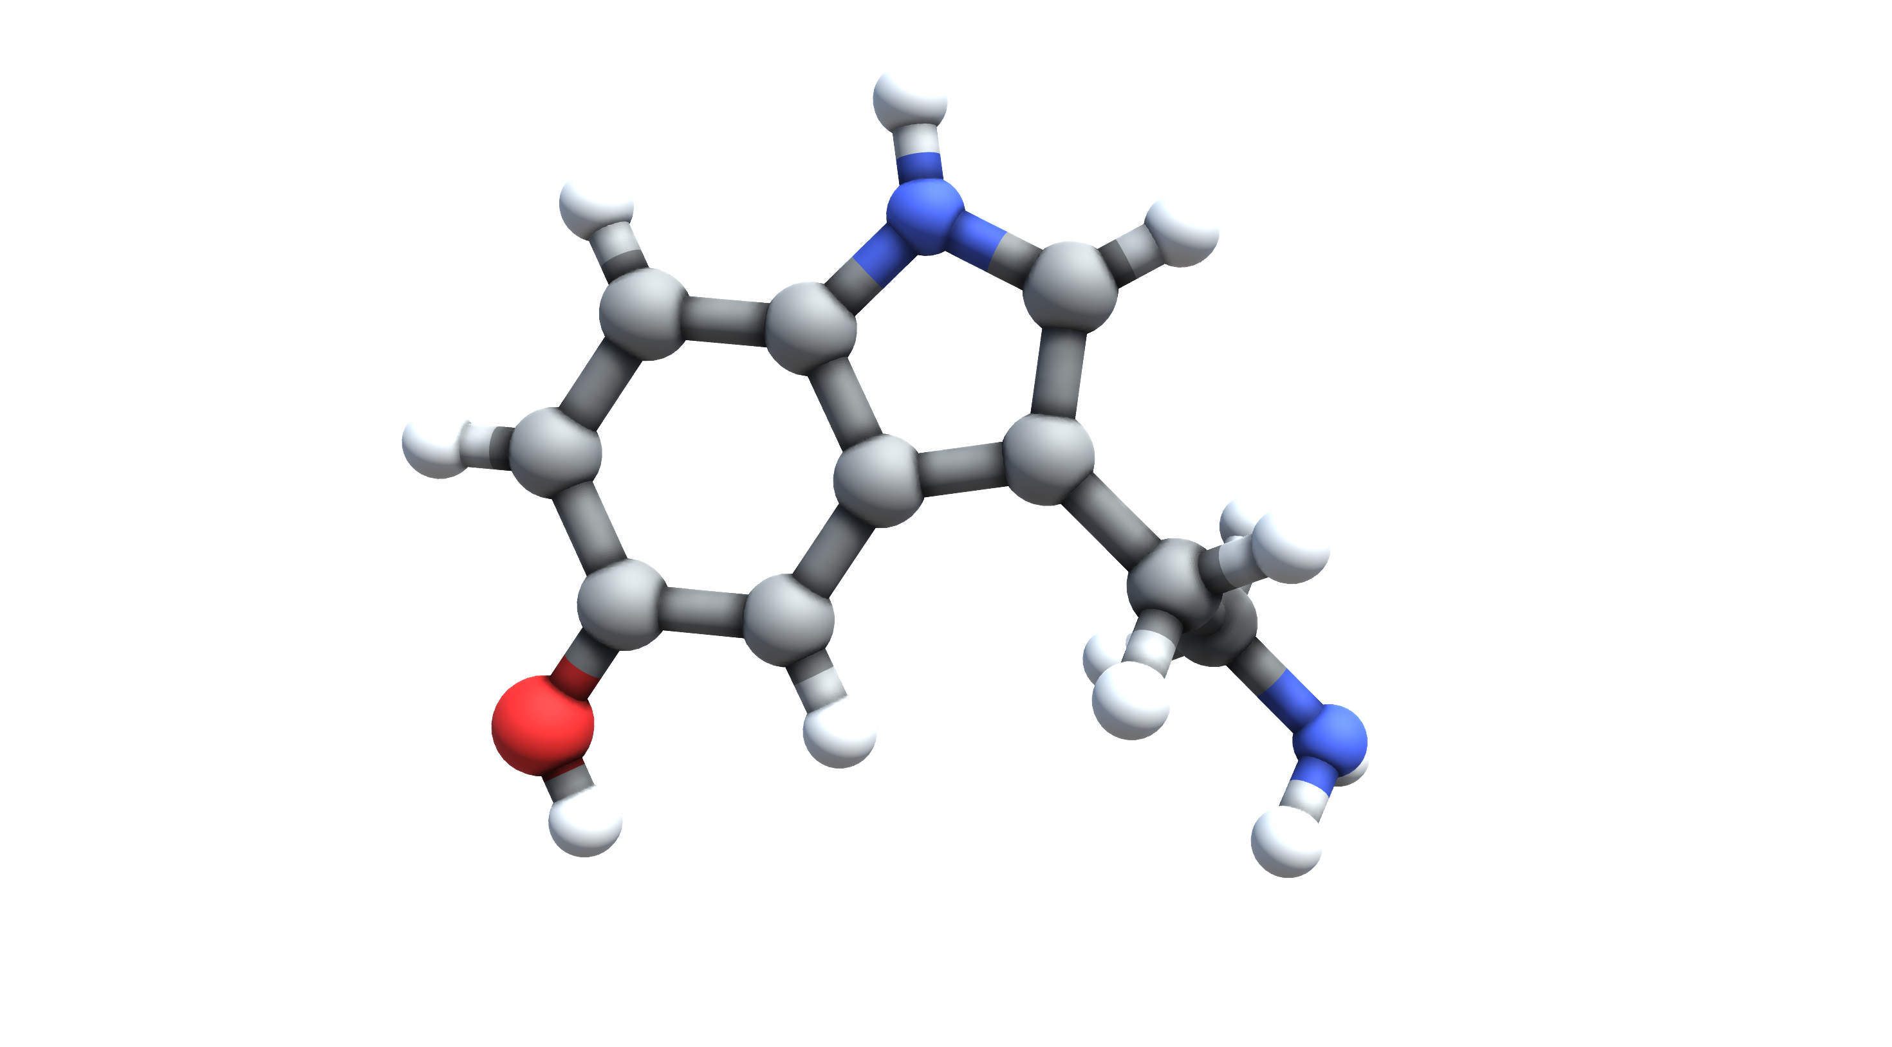
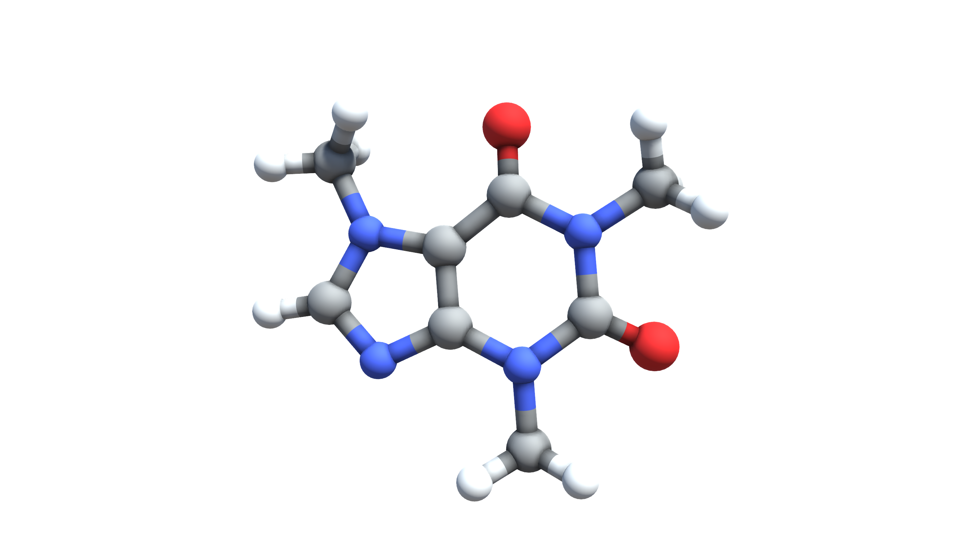
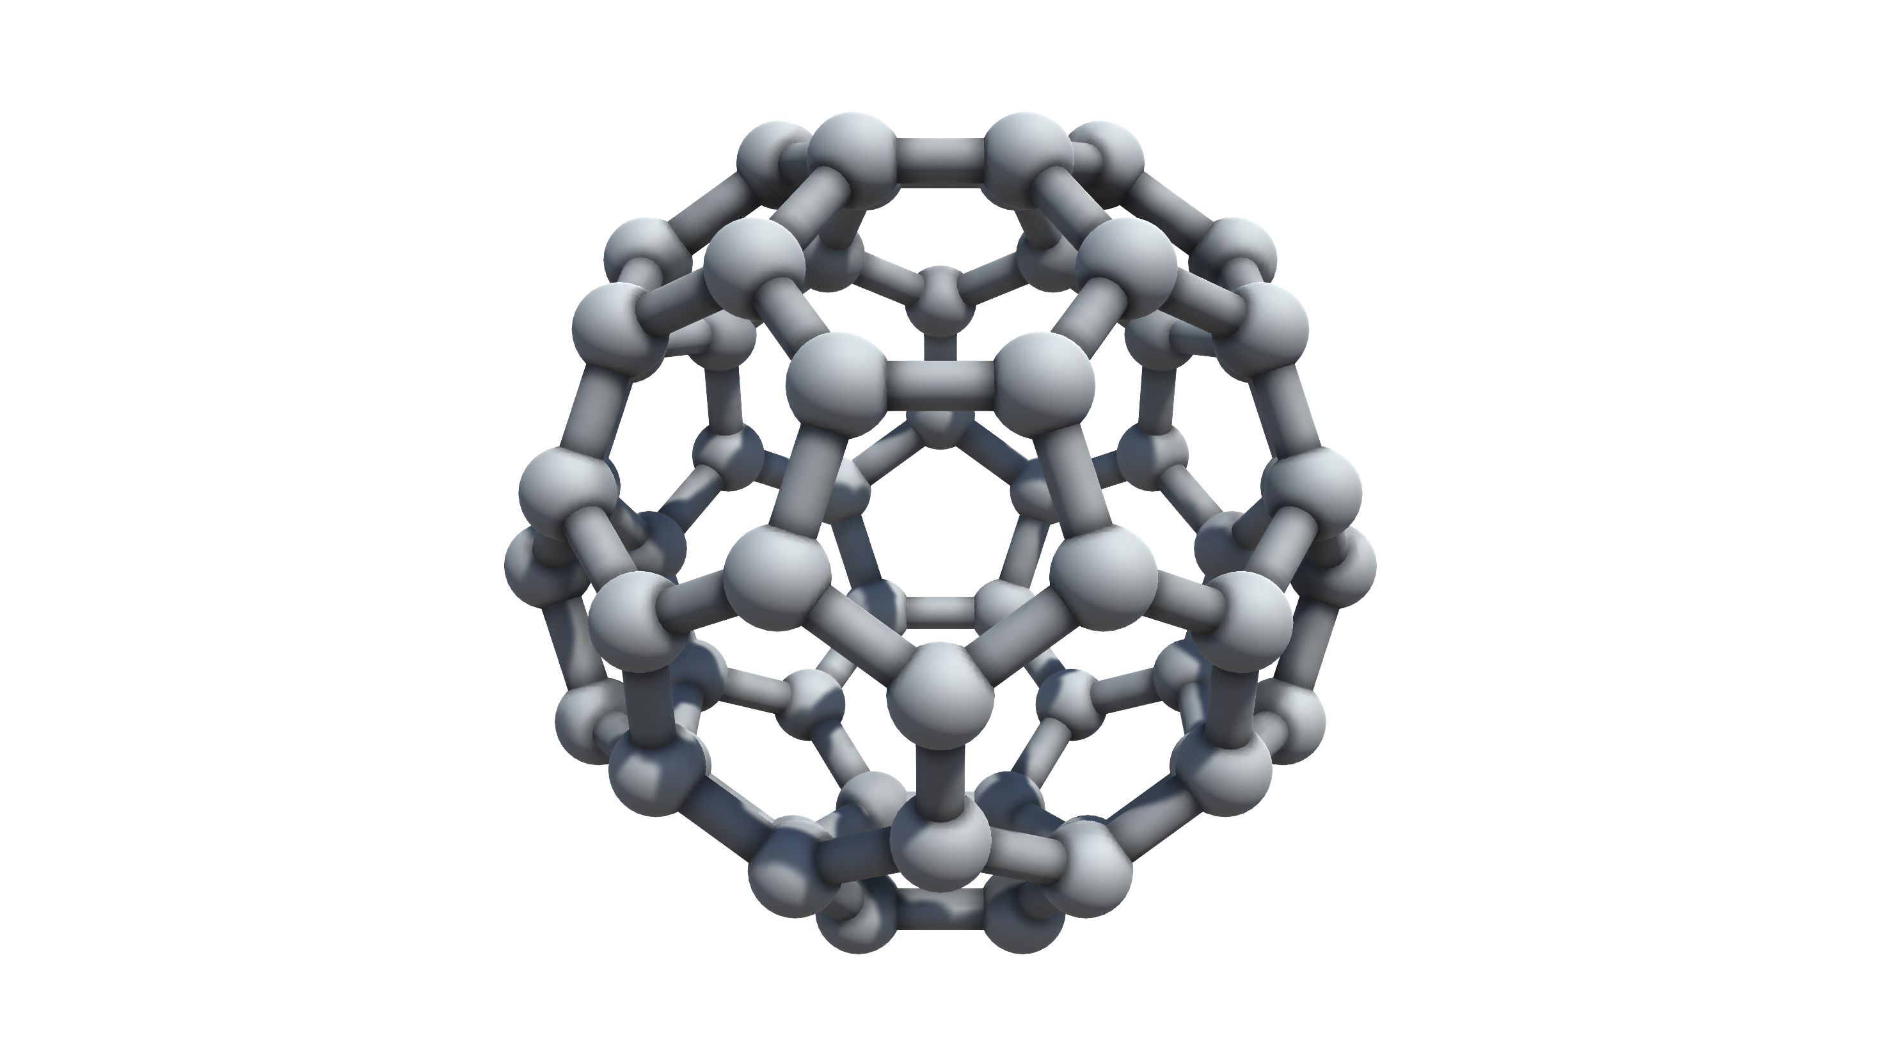
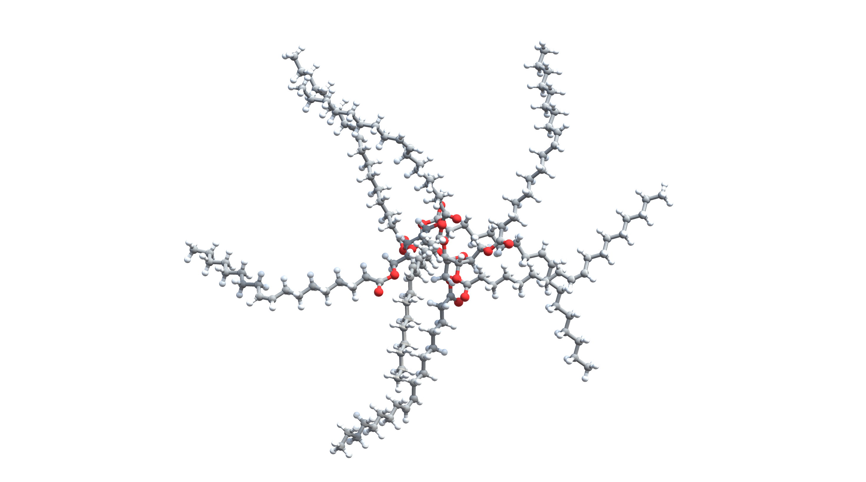
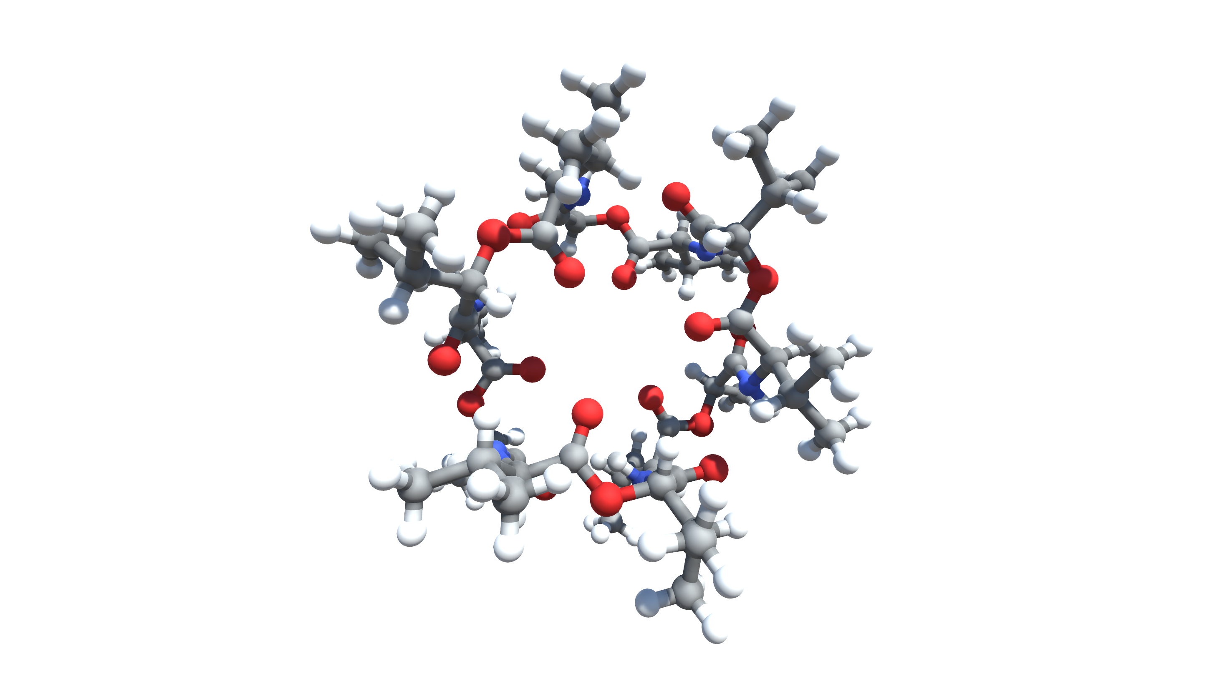
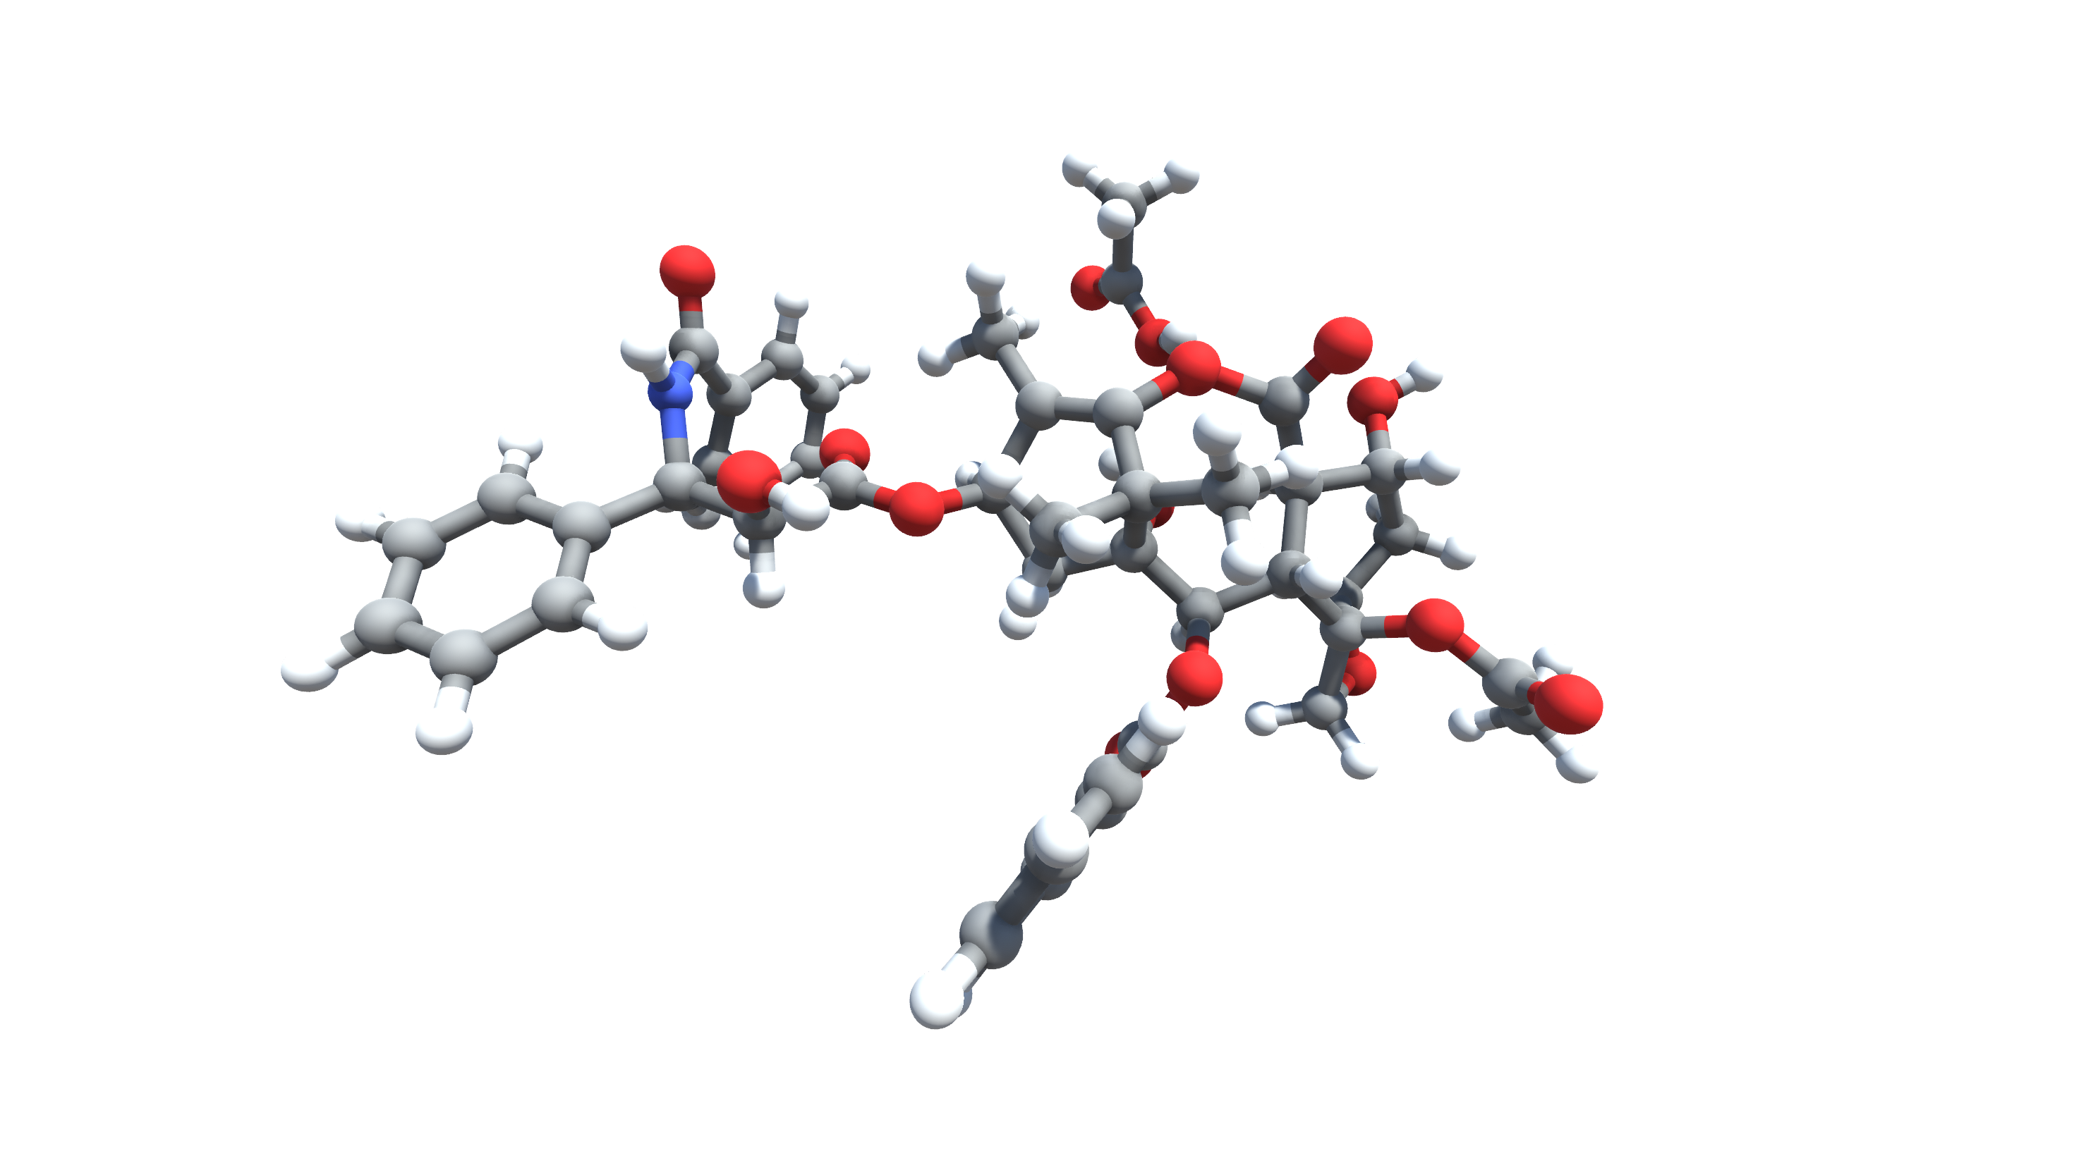
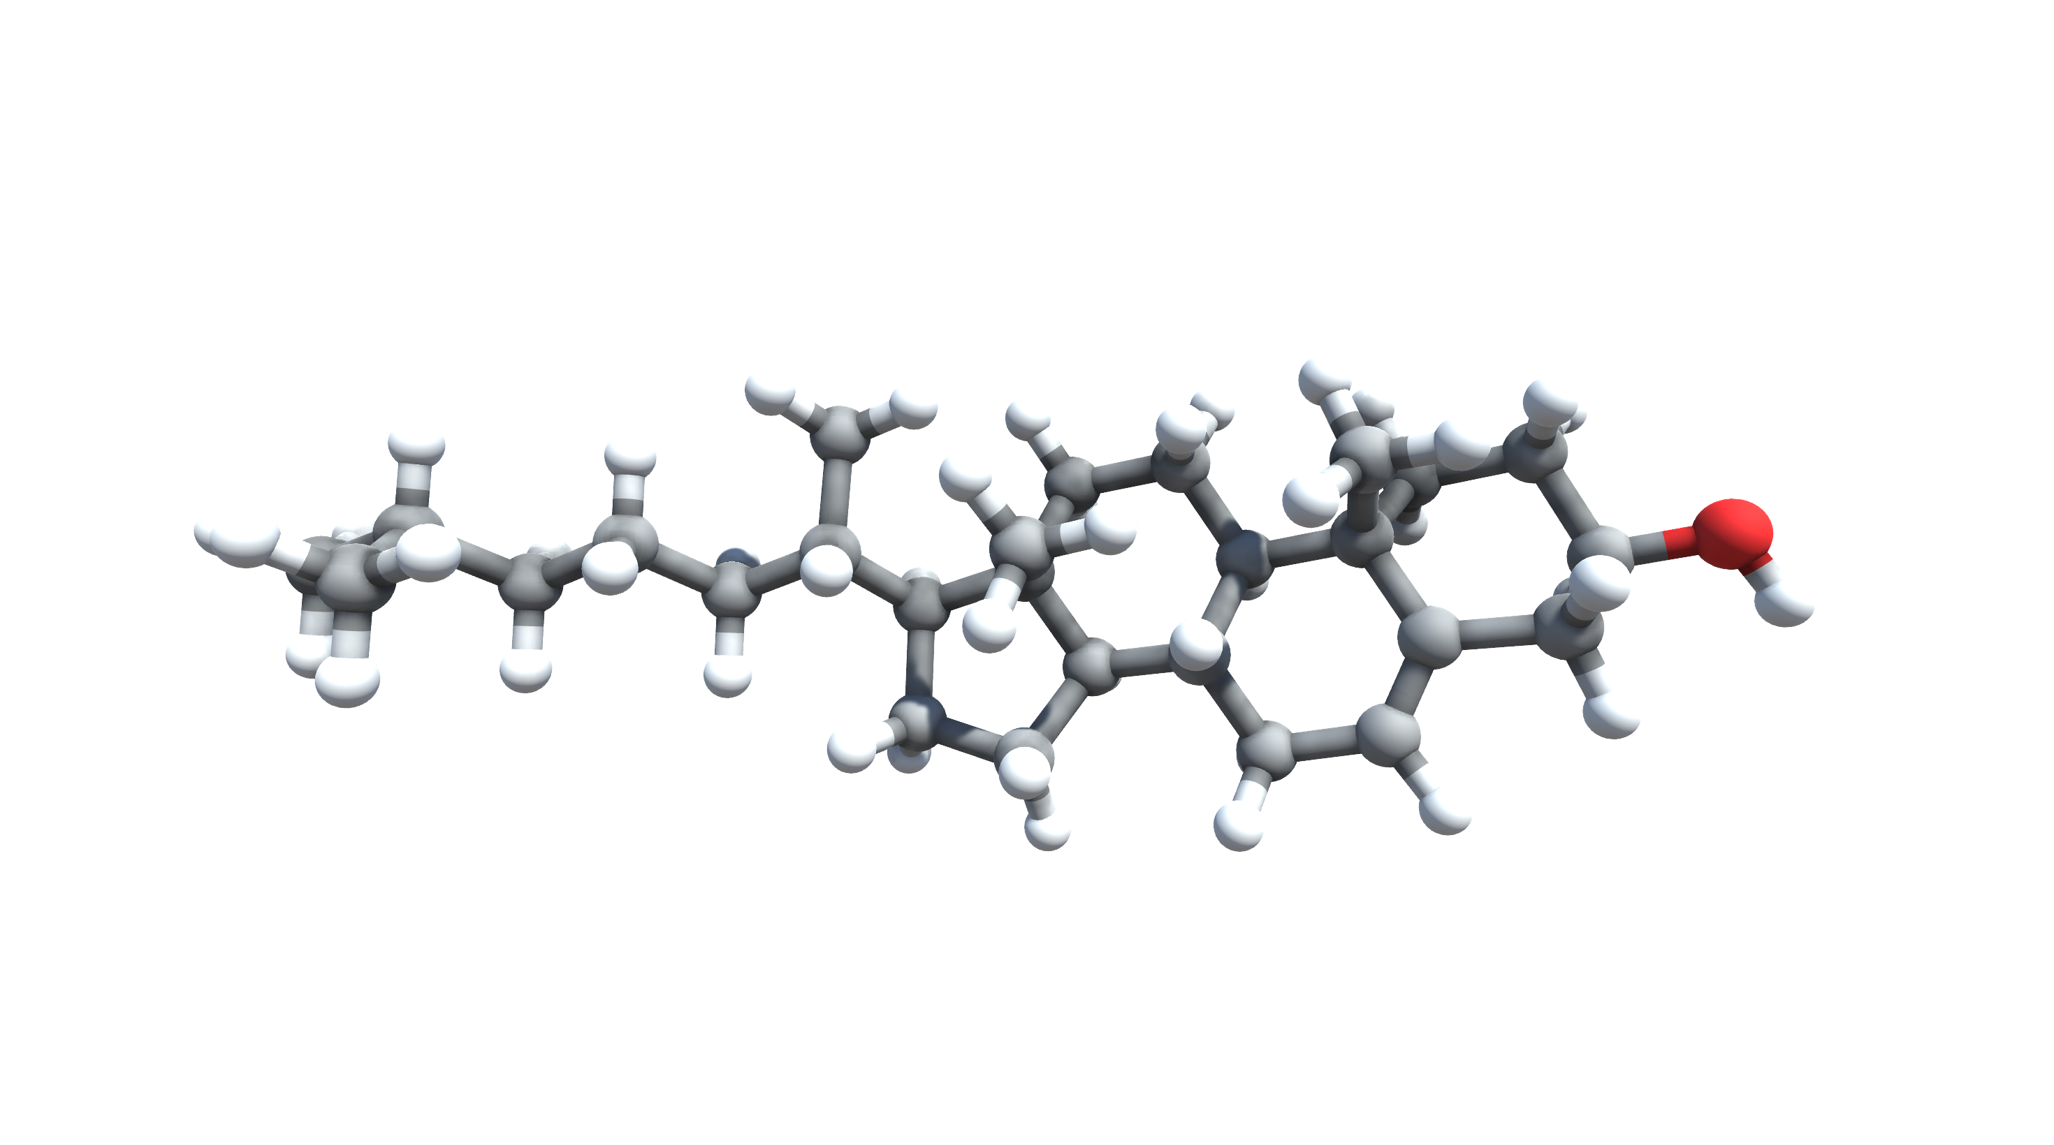
(a)
(b)
(c)
Caffeine
Serotonin
C₆₀
(g)
(d)
(e)
(f)
Olestra
Cholesterol
Taxol
Valinomycin

Slide 4
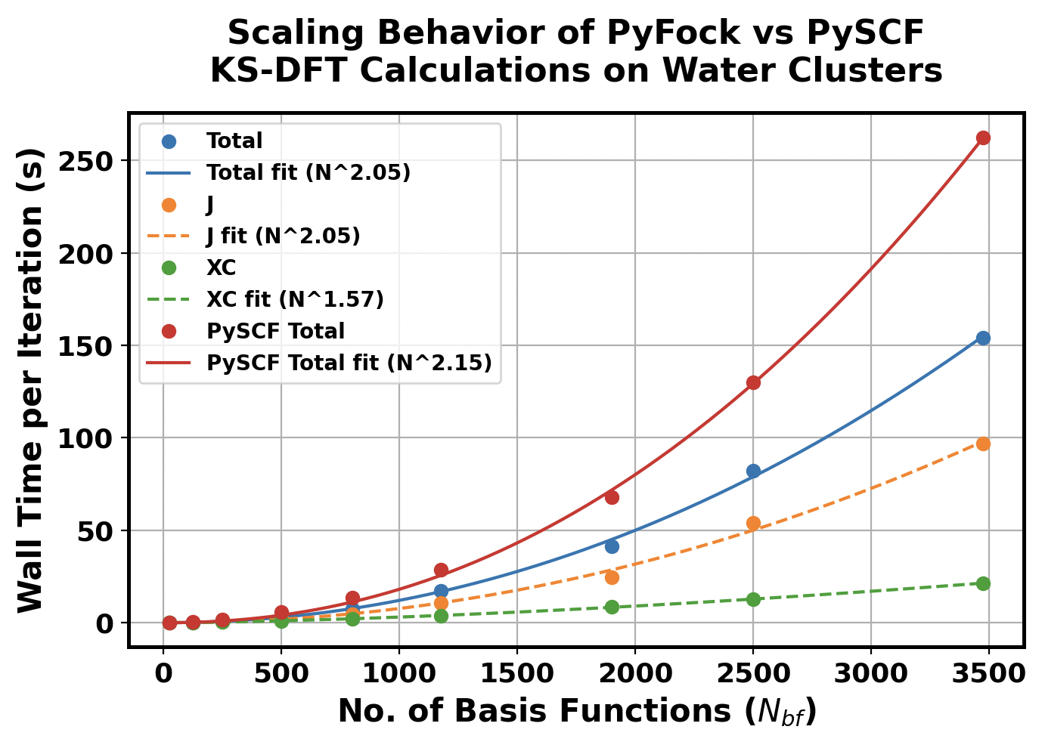
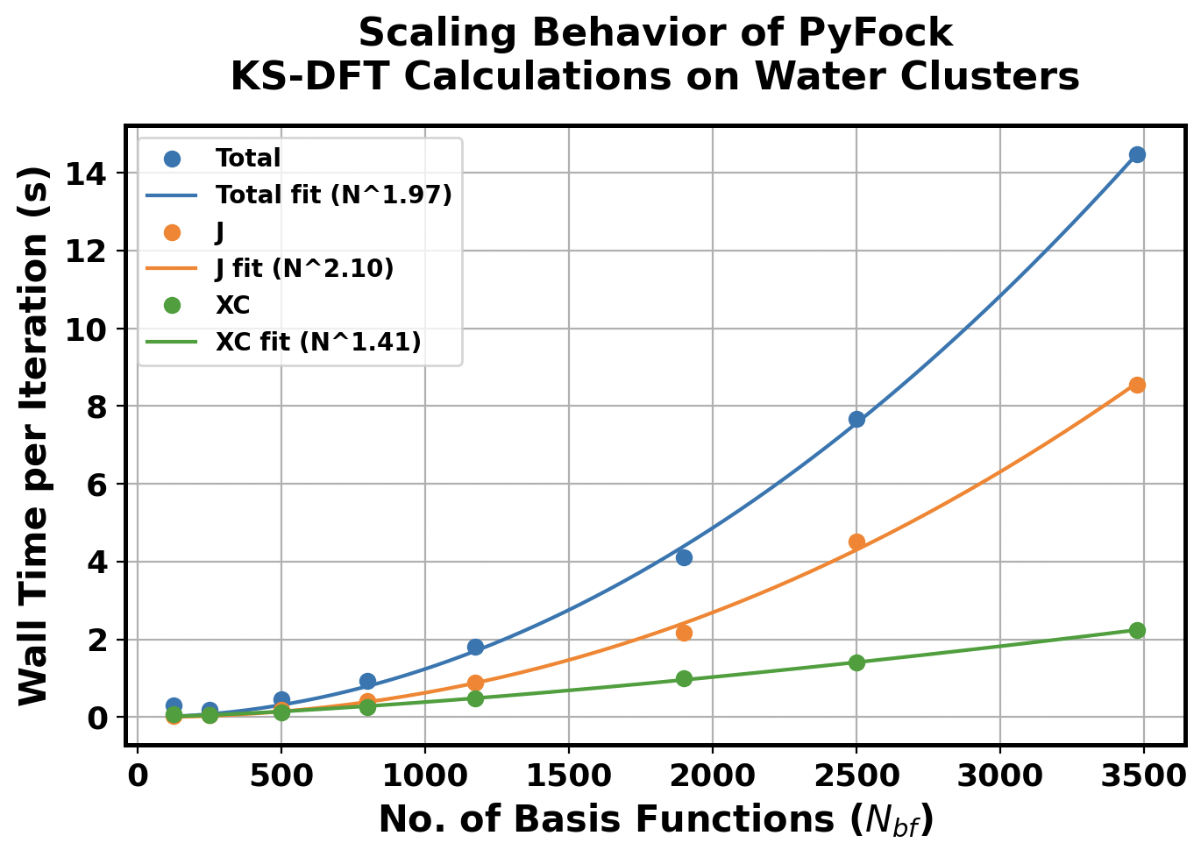
Scaling Behavior of KS-DFT done using
PyFock (CPU) and PySCF (CPU)
PyFock (GPU)

Slide 5
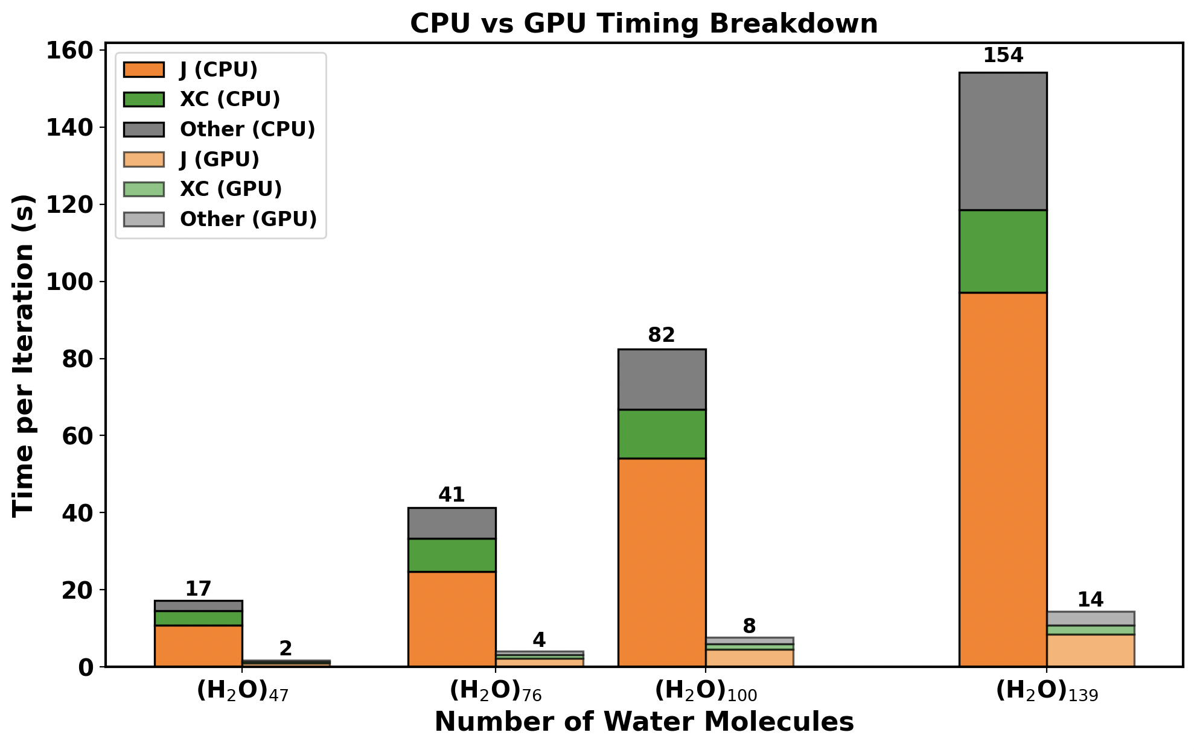

Slide 6


Slide 8
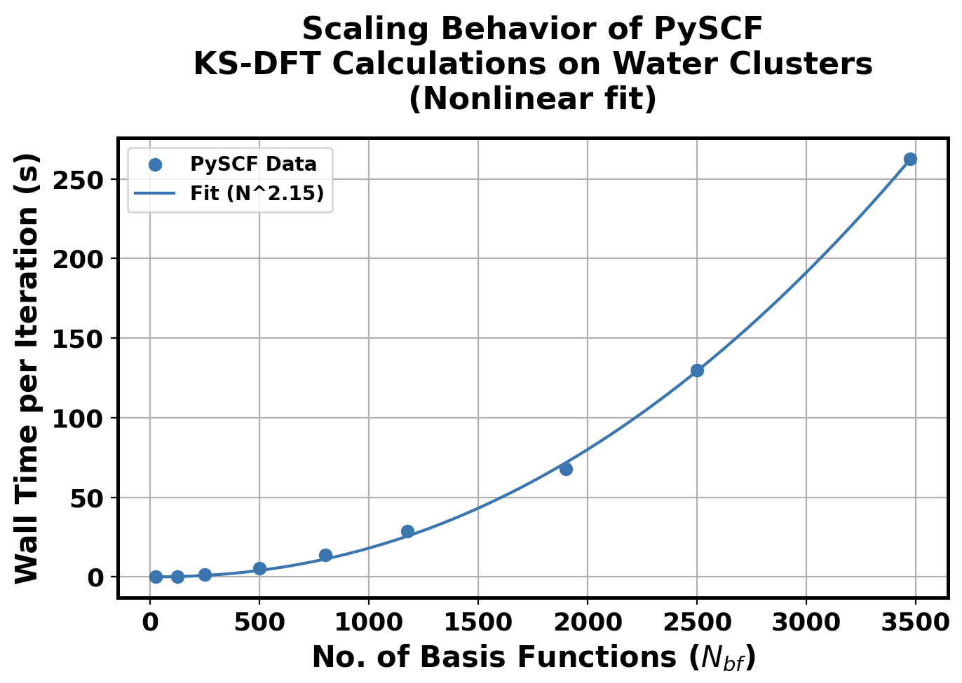

Slide 10
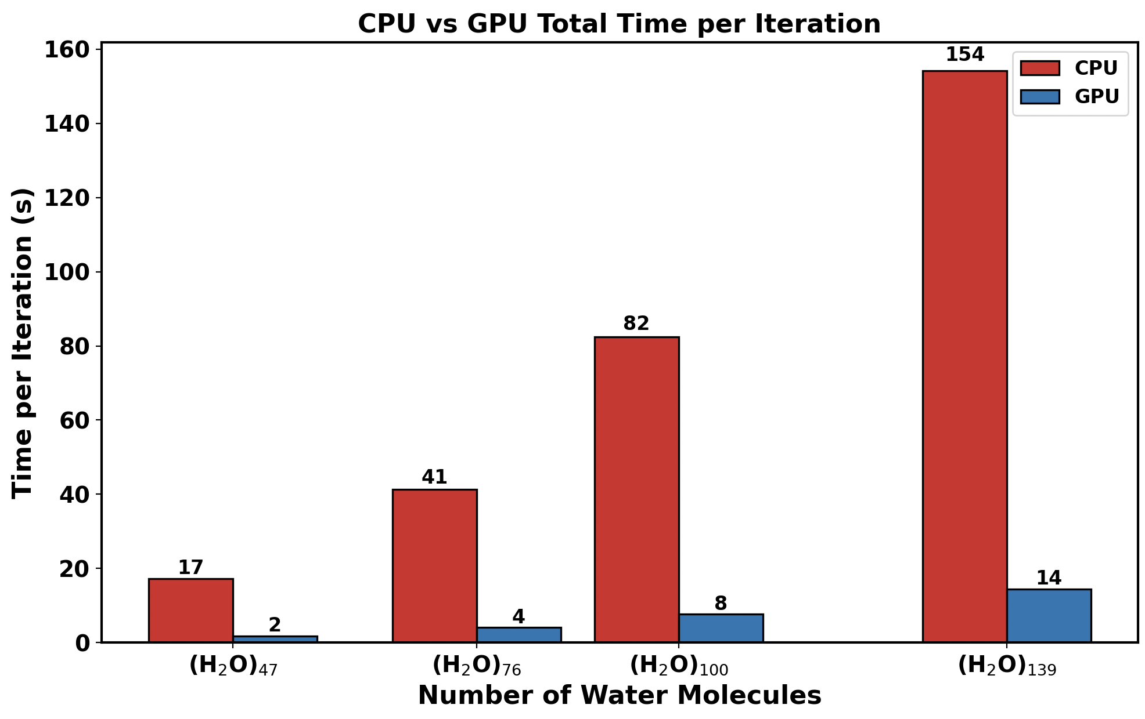

Slide 11
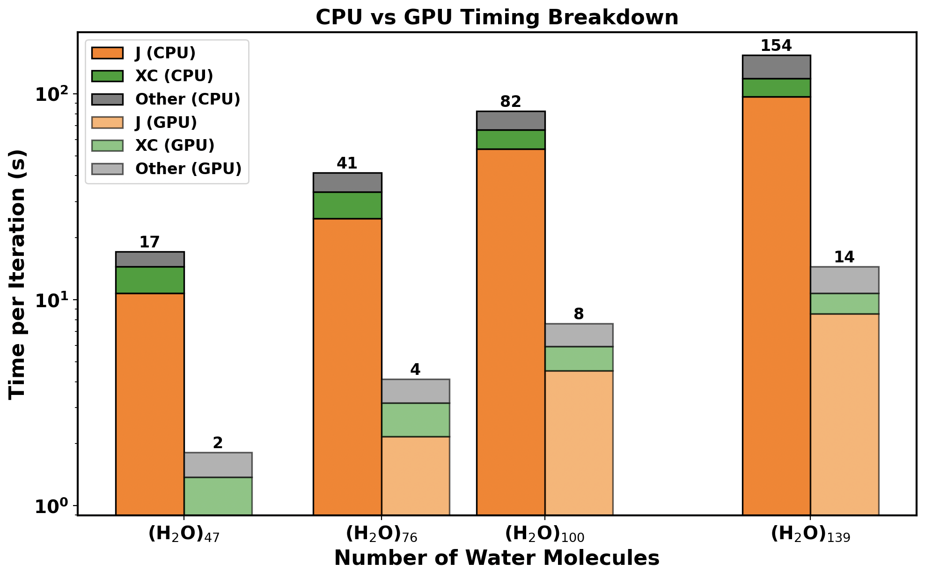

Slide 12
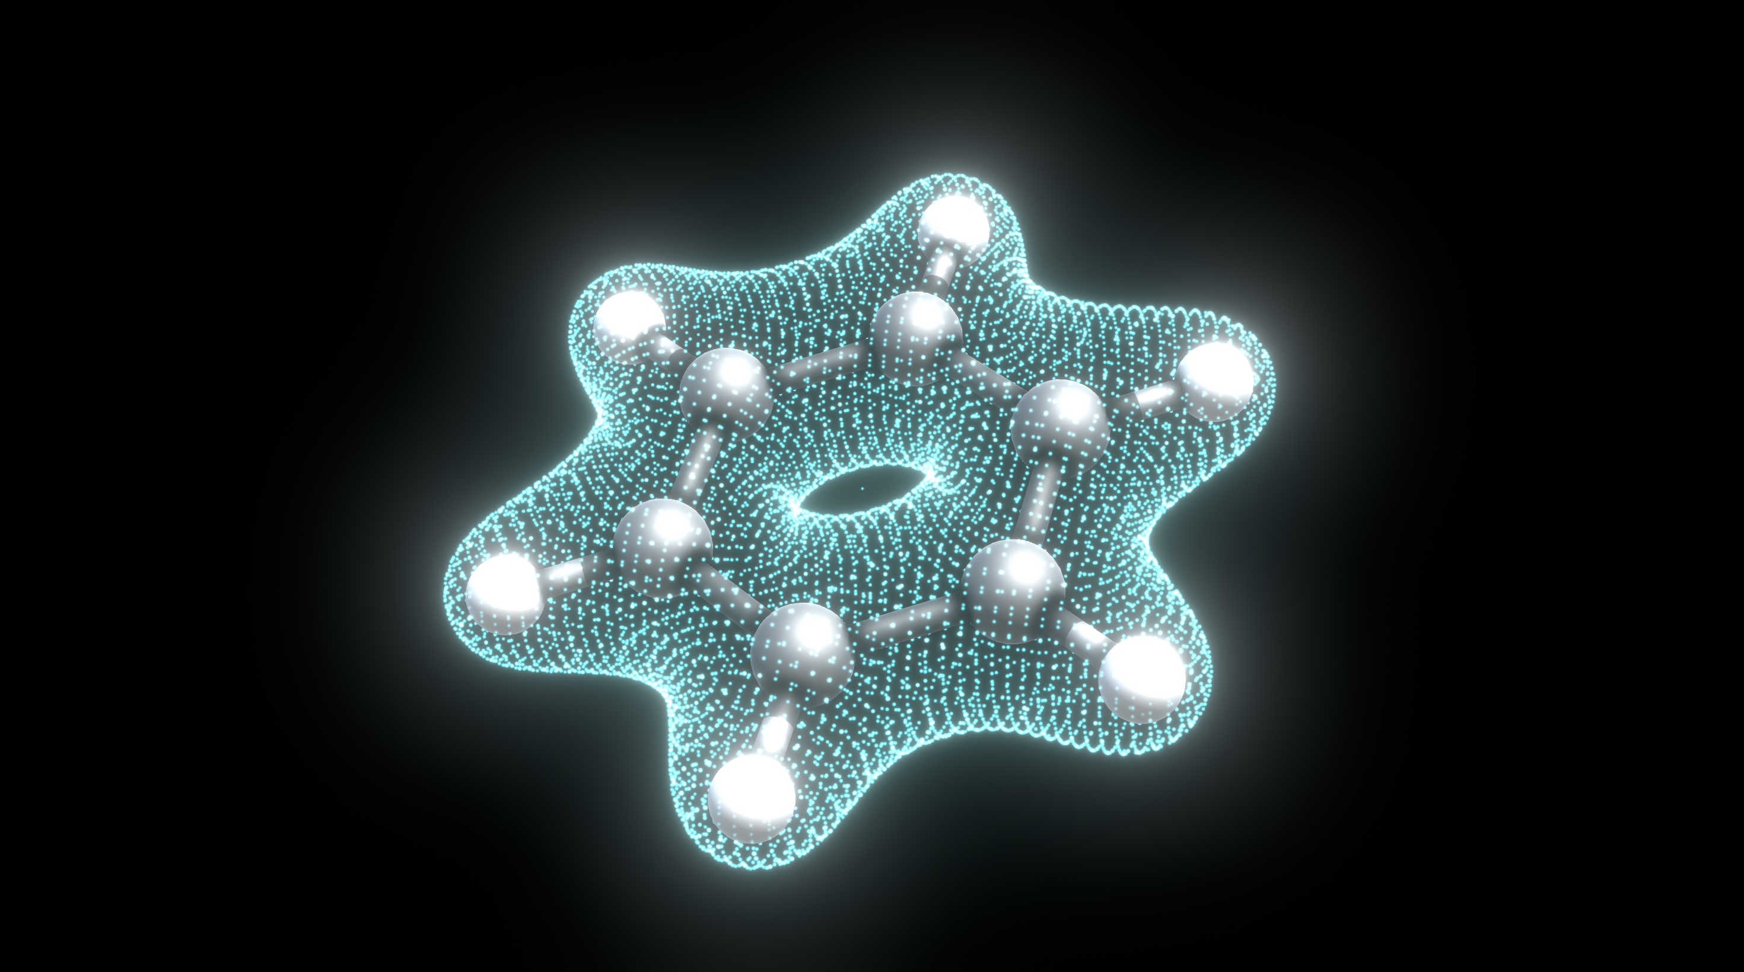
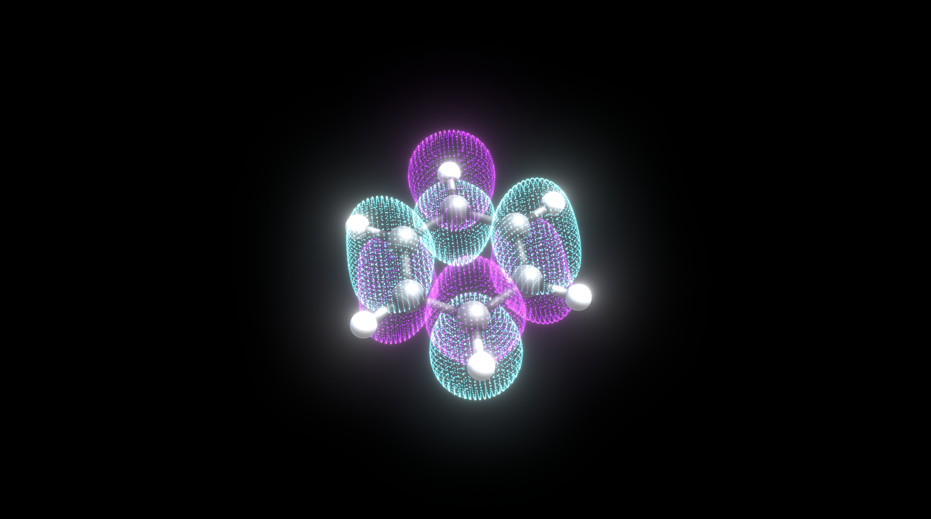
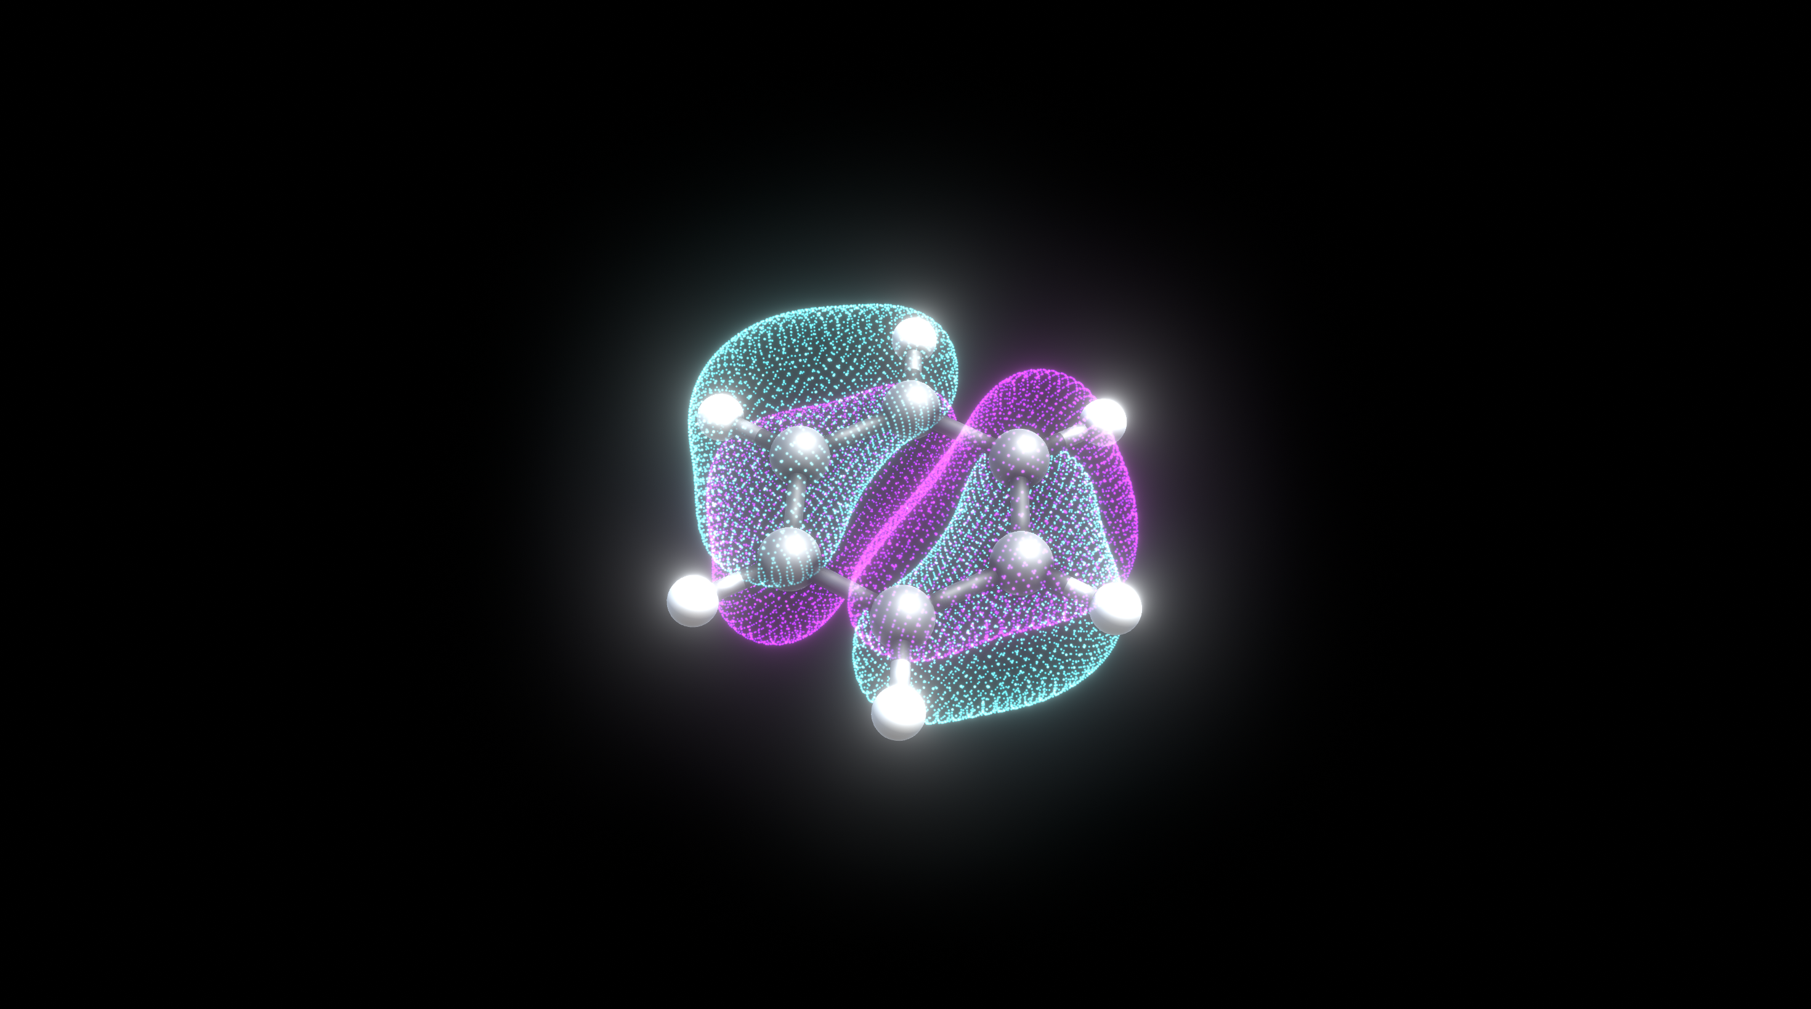
LUMO
Isosurface = +-0.03
Isosurface = 0.07
HOMO
Isosurface = +-0.03

Slide 13
Benzene Electronic Density
Benzene HOMO
Benzene LUMO

Slide 14
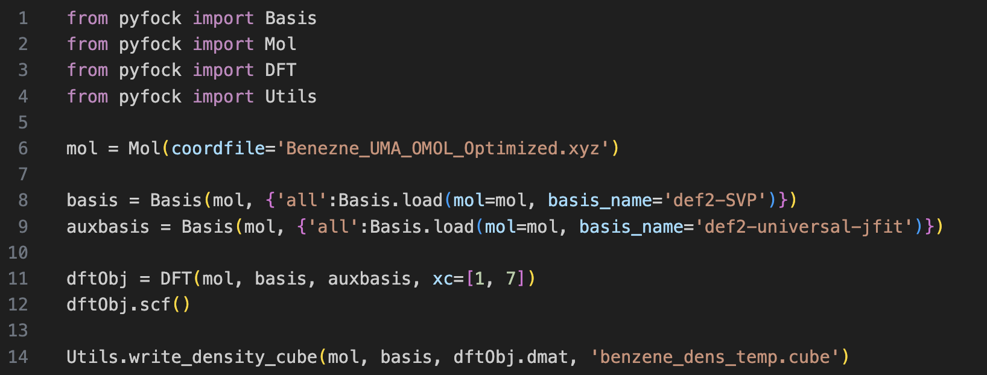
Benzene HOMO
Benzene LUMO
Benzene Electronic Density

Slide 15
